Slide 1

Unit Two
A Good Read

Slide 2

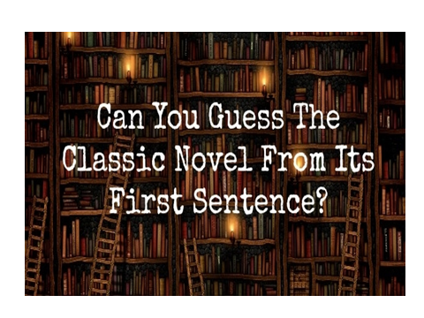
Warm-Up

Slide 3

Text Organization
Danger! Books may change your life

Slide 4

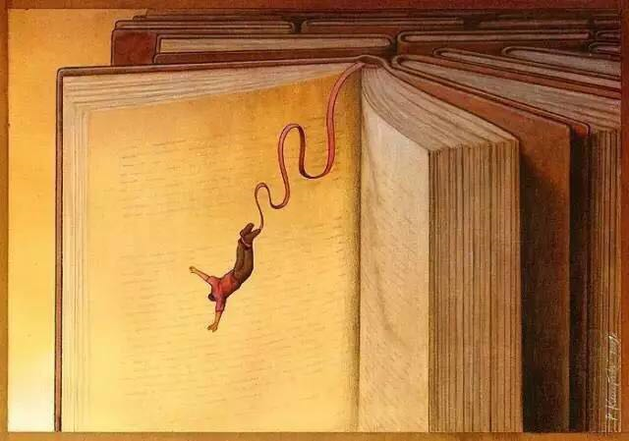
Text Organization
Danger! Books may change your life
What is the intended meaning of “danger”?
A road sign but not a real warning to catch readers’ attention

Slide 5


Can books be harmful as well as dangerous?
Some might be harmful for children or some adults. e.g. pornographic books,
books teaching people tricks, etc.
In what ways can books change people’s life?
Change our life
Give information or knowledge
Stimulate our imagination and courage
Show us other possibilities
Offer us ways to cope with problems
…

Slide 6



Text Organization
Introduction
(Para. 1)
1. The power of reading (Paras. 2-6)
2. The range of reading
(Paras. 7-10)
Conclusion
(Para. 11)

Slide 7
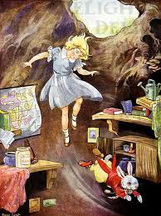
Text Organization
Introduction
(Para. 1)
Like Lewis Carroll’s Alice, who falls into a rabbit hole and discovers a mysterious wonderland, when we pick up a book we are about to enter a new world.

Slide 8
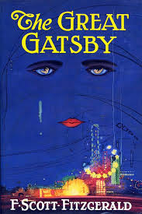

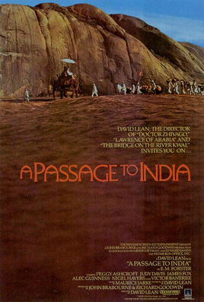
Text Organization

Slide 9
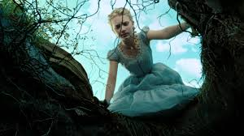
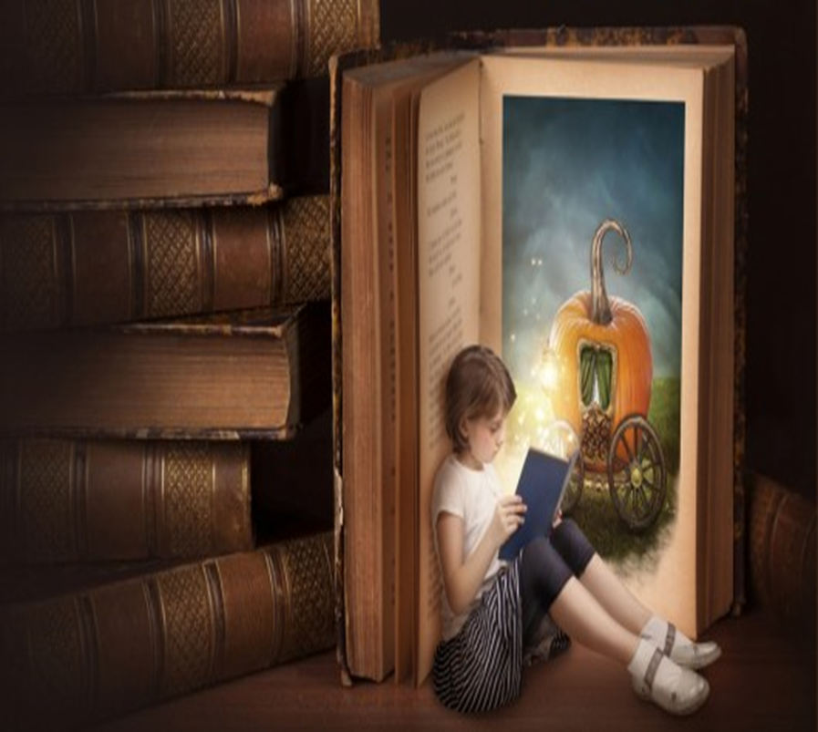
Introduction
Comments on reading
Enter a new world
Liberate us from the real world we come from

Slide 10

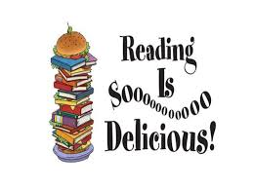
(Paras. 2-6)
Paras. 2-3: Enjoy and celebrate the variety and difference in safety and provide us an opportunity to grow
Para. 4: Go to read if we ever question the power of reading
Para. 5: Stimulate our emotions.
Para. 6: Influential in the way we live from our childhood

Slide 11
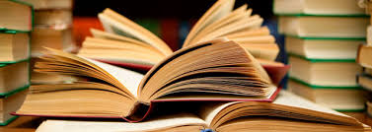

The range of reading
(Paras. 7-10)
Paras. 7: Thomas Merton’s answers for 7 questions about reading
Paras. 8-10: Home-run book

Slide 12
Topic-guided reading
Read paras. 2-6 and locate the topic sentence in each paragraph.
Variety and difference appear more as a threat than an opportunity.
Para. 2
Reading books allows us to enjoy this variety and difference in safety and provides us with an opportunity to grow.
Para. 3
If we ever question the truth of the power of reading books, we should take the trouble to go to...
Para. 4

Slide 13
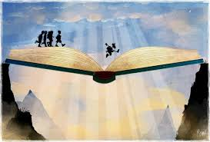
Topic-guided reading
Read paras. 2-6 and locate the topic sentence in each paragraph.
The power of reading
Our emotions are stimulated.
Other people/cultures aren’t distant.
Para. 5
Para. 6
As soon as we are able to listen, books are supremely influential in the way we live.

Slide 14
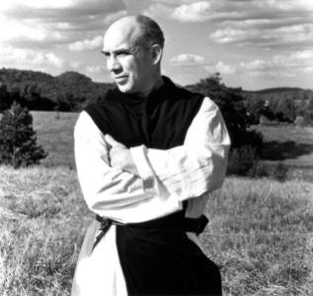
Text Organization
Thomas Merton (1915–1968), the American monk, priest and writer,
Seven questions about reading
Which are the last three books you have read?
Which three books you are reading now?
Which books do you intend to read?
Which books have influenced you?
How did they influence you?
Which book do you think everyone should read?
Why should they read it?

Slide 15
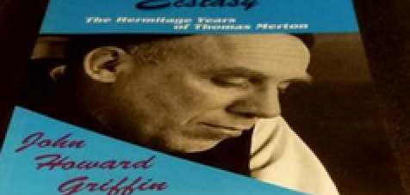


Books have influenced
William Blake’s poetic works
Plays by ancient Greek thinkers and writers
Religious writings
to discover the real meaning of my life
to get out of the confusion and meaninglessness of the current society

Slide 16


Read paras. 8-10 and then give the definition of the following 2 terms.
A baseball player hits the ball so hard and so far he’s able to run round four bases of the diamond and score points not only for himself but for the other runners already on a base.
Home-run
It refers to the first time they read a book which induces such pleasure and satisfaction that they can’t put it down.
Home-run book

Slide 17
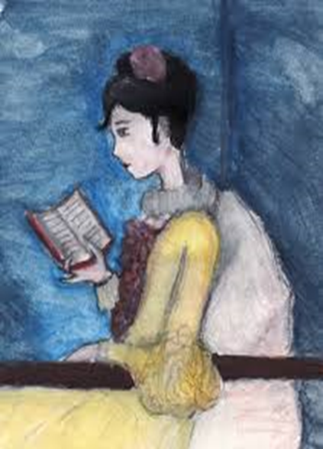
Read para. 10 and extract 2 key words relevant to the effect of home-run books.
Pleasure
We’ll remember the pleasure and satisfaction which awaits us and eagerly, insistently, sometimes even desperately seek to reproduce the marvelous sensation again.
Hunger
We cannot withstand the hunger to visit another world, to meet different people, to live other lives and to reflect on ourselves.

Slide 18
Summary
Reading is a life-changing activity. It helps us enter a new world and liberate us from the real world we come from; it stimulates our emotions and allows us to enjoy and celebrate the variety and difference from books; it aids us to get out of confusion in a material world and to discover the real meaning of life. Simply put, books are supremely influential in the way we live.
Home-run book might be the answer for the book that everyone should read. It describes the first reading experience that induces such pleasure and satisfaction that you cannot put it down and it may range from the classics to the most recent. Everyone is looking for their own home-run books. And what is yours?

Slide 19
Summary
Reading is a life-changing activity. It helps us enter a new world and liberate us from the real world we come from; it stimulates our emotions and allows us to enjoy and celebrate the variety and difference from books; it aids us to get out of confusion in a material world and to discover the real meaning of life. Simply put, books are supremely influential in the way we live.
Home-run book might be the answer for the book that everyone should read. It describes the first reading experience that induces such pleasure and satisfaction that you cannot put it down and it may range from the classics to the most recent. Everyone is looking for their own home-run books. And what is yours?

Slide 20

mysterious & mystical
mysterious
full of secrets 指神秘的，同时引起惊奇和好奇而且难以解释或无法理解的。
mystical
relating to or characteristic of mysticism 指神秘主义的，理智无法理解、感官不能接触的精神现实或含义的; 难以理解的，神秘的。
Match the phrases with correct words.
1. the _________ style of William Blake
威廉· 布莱克的神秘风格
2. For me, standing before the temple door as the sun rose was a __________experience.
旭日东升，我站在神殿门前，体验到油然而生的敬畏之情。
3. A ___________ light came from the deserted house.
废弃的房屋里亮起了神秘的灯光。
mystical
mystical
mysterious

Slide 21
induce & deduce
induce
to cause something, esp. a mental or physical change 引起、导致
deduce
conclude by reasoning 演绎; 推断
Examinations do not motivate a student to read widely, but to restrict his reading; they do not enable him to seek more and more knowledge, but __________ cramming.
We can __________ from the picture that its aim is to criticize the spreading extravagant behavior among students, especially college students.
induce
deduce

Slide 22
interact with
－ to communicate with one another, while performing an activity together 相互交流、互动
Translate the following sentences.
1. 但是他说，科学本身是不够的，“科学家需要与经济学家和决策者互动——我们需要适当的对话”。。
But science itself is not enough, he added, "scientists have to interact with economists and policymakers — we need proper dialogue".
2. These trends will reshape the way the Chinese interact with the rest of the world over the next generation.
这些趋势会重塑中国人和外界将来的沟通方式。

Slide 23

peace and quiet
the calm quiet situation in which you are not annoyed by noise or other people 静谧、安静
Translate the following sentences.
And anyone favoring the tranquil idle over the agitated life in the thriving center, will find peace and quiet at heart of nature in the wide Davos outdoors.
任何喜爱田园般的恬静生活而不喜欢繁华市中心浮躁喧嚣的人，都会在达沃斯广阔的野外大自然的中心找寻到平静与安宁。
去远离城市生活的偏僻村庄，享受不受干扰的宁静吧！
Please enjoy undisturbed peace and quiet in isolated villages remote from town life.

Slide 24
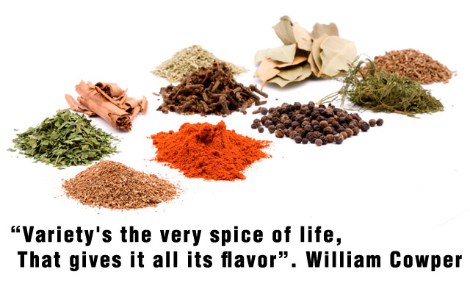
the (very) spice of life
Spices are made from plants and added to food to give it its particular flavour or taste. This quote from Cowper’s poem means that variety gives life extra value and allows you to appreciate life in particular ways.
……变化是生活的调味品，它让生活变得有滋有味……

Slide 25
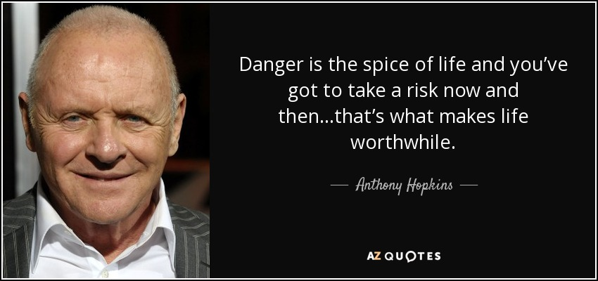
the (very) spice of life
生命的多彩在于交友。
The spice of life is to make friends.
2. Stress is the spice of life, complete freedom from stress is death.
压力是生活的调味品，彻底摆脱压力的是死亡。
Epigram

Slide 26

have something in common
to have the same interests or opinions as someone else 与某人有共同点
Combine the following sentences into one.
它们的共同之处是把娱乐、学习和机会结合在一起。
1. They have something in common.
2. They combine fun with the opportunity to learn something.
click
What they have in common is that they combine fun with the opportunity to learn something.
have sth. in common

Slide 27
seek out
to find sb. or sth. by looking for them in a determined way (下决心) 找到
Translate the following sentences.
A talker is attracted to someone who likes to listen, or an aggressive personality may seek out a more passive partner.
健谈的人对于喜欢倾听的人来说很有吸引力，敢作敢为的人想要找一个相对温顺一点的伴侣。
我们找个僻静的地方，去痛哭一场吧。
Let us seek out some desolate shade, and there weep our sad bosoms empty.

Slide 28
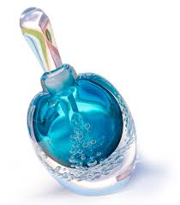

be enchanted by
to be attracted very strongly 着迷于，陶醉于
be intoxicated with
be fascinated with
be drunk with
be caught by
be enraptured by
be obsessed by
be steeped in/into
be indulged in/into
Find similar phrases which also express the meaning of “be enchanted by / with”.

Slide 29
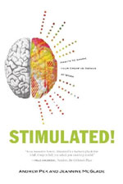
be stimulated by
to be encouraged by 被刺激
Translate the following sentences.
The wider sense of patriotism to the country could only be stimulated by the invasion from the outside forces.
只是在面对异族入侵时，传统意义上的爱国情感才能被激发出来。
2. Stimulated and strengthened by two World Wars, the community understands very fully the foolish uses for which aircraft can be exploited.
两次世界大战的刺激和强化让公众充分认识人们会用飞机去做多么愚蠢而荒唐的事。

Slide 30
be immersed in/into
spending most of the time doing sth. or thinking about sth. 沉浸于···，深陷于···
Translate the following phrases.
深陷于丑闻
陷入债务之中
沉浸在幸福的
回忆中
陷入沉思中
debt
happy memories
meditation
scandal
be immersed in

Slide 31
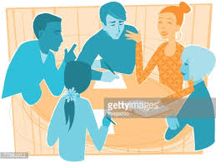
be immersed in/into
Translate the following sentence into Chinese.
Modern children are so immersed in the electronic media that they have little or no awareness of the marvelous world to be discovered in books.
如今的孩子们如此沉迷于电子媒体，他们很少或者根本不了解书中所能发现的神奇世界。
Discussion
To what degree do you agree with this statement?

Slide 32

We’ll have experiences which are new, sometimes disconcerting, maybe deeply attractive, possibly unpleasant or painful, but never less than liberating from the real world we come from. (Para. 1)
Whatever experience you get in reading, it can always liberate us from the real world for some time.
Translate the sentence into Chinese.
我们可以体验未曾经历过的事情，这些事情也许令人困惑，也许引人入胜；可能是不愉快的，也可能是令人痛苦的，但无论如何都至少能把我们从现实世界中解放出来。

Slide 33
Variety’s the very spice of life, / That gives it all its flavour.
Spices are made from plants and added to food to give it its particular flavour or taste. This quote from Cowper’s poem means that variety gives life extra value and allows you to appreciate life in particular ways.
……变化是生活的调味品，它让生活变得有滋有味……

Slide 34
the (very) spice of life
生命的多彩在于交友。
The spice of life is to make friends.
2. Stress is the spice of life, complete freedom from stress is death.
压力是生活的调味品，彻底摆脱压力的是死亡。
Epigram

Slide 35

Language Points
We even understand, however fleetingly, that we have more in common with other readers of books in other cultures than we might do with the first person we meet when we step out of our front doors. (Para. 3)
In reading we will find that we have more in common with readers of other cultures than we might have with the people we meet or know in our life.
翻译：
我们甚至感觉到——哪怕只是在一瞬间——我们和其他文化读者的共同点或许要多于我们和家门口随便碰到的一个人的共同点。

Slide 36
We learn to look beyond our immediate surroundings to the horizon and a landscape far away from home. (Para. 3)
Identify the metaphor in this sentence.
our immediate surroundings: our familiar environment 周遭的环境
The horizon and a landscape far away from home: 天边和异域山水
此句使用隐喻的手法，将 immediate experience 比作immediate surroundings, 将 completely different things that we imagine to experience 比作 the horizon and a landscape。
Translate the sentence into Chinese.
我们学会把目光移出我们周围的环境，投向天边，去领略一下异域风光。

Slide 37
Identify the meaning of “beyond … to …”.
We have witnessed this particular crisis spreading beyond Asian countries to Latin America and even Eastern Europe.
我们目睹这场风暴不但蔓延至亚洲许多国家，甚至波及拉美和东欧。
(2) Its application has extended beyond physics into, for example, biology and economics.
它的应用已经超越了物理学的范畴而进入到生物学和经济学的范畴。
limits / limitation
boundaries
scope / range
confines
reach
go beyond
transcend
extend
overstep
超越
the
of…

Slide 38
Translate the following phrases.
exceed the authorization limits of the Security Council
超越安理会的授权范围
go beyond the range of human knowledge / the reach of human understanding
超越人类的知识/理解范围
超越科学范围
transcend the confines of science
超越本研究的范围
extend the scope of this survey
overstep one’s authority / the limits of power
超越权限的范围
Notes:
点击中文图形框，出现英文翻译。

Slide 39
I suggest that the only books that influence us are those for which we are ready, and which have gone a little further down our particular path than we have gone ourselves. (Para. 6)
Identify the sentence structure.
for which we are ready: 介词 for 置于引导词前，“做好了准备”
… have gone a little further than we have gone ourselves: 比我们自己走得更远一些，此处指这些书籍的眼界比我们更高，对我们具有指导性。
down the particular path: 沿着特殊的道路
此句为复合句，由which引导两个定语从句，修饰those。
Translate the sentence into Chinese.
我认为能影响我们的书籍是那些我们已经准备要读的书，它们只是在我们已经选定的道路上走得比我们更远一些而已。

Slide 40
These books ... and meaninglessness of an existence completely immersed in the needs and passivities fostered by a culture in which sales are everything. (Para. 7)
Identify the sentence structure.
此句为由多个定语及定语从句构成复合句，主句结构为 These books have helped me…, and have made it possible for me to do…, to get out of the confusion and meaninglessness 为动词不定式构成的形式宾语，为 it 指代的内容。
an existence 为介词 of 的宾语，过去分词 completely immersed in…作 为后置定语，在此处再套嵌了另一个过去分词的后置定语fostered by a culture, 修饰 the needs and passivities, 其后套嵌了第三个定语，为 which 所引导的定语从句修饰 a culture。
Translate the sentence into Chinese.
销售就是一切的文化培育了人们无止境的需求和消极被动，生活充满了困惑和空虚，而书籍则把我从这种困惑和空虚中解脱了出来。

Slide 41
1.发现一个神奇的仙境
1. discover a mysterious wonderland
2.从现实世界中解放出来
2. liberate from the real world
3.生活的调味品
3. the very spice of life
4.与其说是机会毋宁说是威胁
4. appear more as a threat than an opportunity
5.与他人交流
5. interact with other people
6.步出前门
6. step out of the front door
7.超越周遭的环境
7. look beyond the immediate surroundings
8.壮观景象
8. the striking vistas

Slide 42
Useful Expressions
9.从经典小说到最近出现的
9. range from the classics to the most recent
10.思考别样的人生
10. reflect on the other lives
11.痴迷于······
11. be enchanted by
12.感觉被排除在外
12. feel excluded
13.调动情感
13. stimulate one’s emotions
14.对我们的生活方式产生很大的影响
14. supremely influential in the way we live
15.睡前故事
15. bedtime story
16.一直到······
16. all the way through to …

Slide 43
17.对······所具有的神奇的支配力
17. a mystical power that sth. possess over sb.
18.发现人生真谛
18. discover the real meaning of our life
19.摆脱困惑和无意义
19. get out of confusion and meaninglessness
20. be immersed in needs and passivities
20.深陷于需求和被动中
21.创造了某个术语
21. coin a term
22.全垒打书籍
22. home-run books
23.击出全垒打
23. hit a home run

Slide 44
24.跑完四个垒
24. run round the four bases of the diamond
25.得分
25. score points
26.已在垒上的选手
26. runners (who are) already on a base
27.带来愉悦和满足
27. induce pleasure and satisfaction
28.疯狂地寻求
28. desperately seek to do …
29.重复体验某种感觉
29. reproduce the marvelous sensation
30.遏制某种渴求
30. withstand the hunger to do …

Slide 45

Cultural Notes

Slide 46


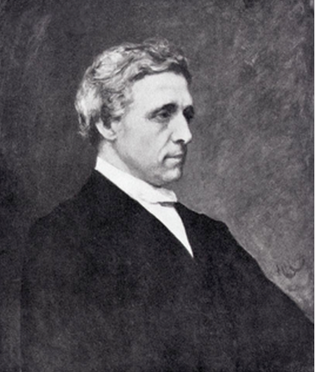
Words & Phrases
Lewis Carroll
Lewis Carroll (1832–1898) is the pen name of Charles Dodgson. He was an English writer, priest, mathematician who taught at Oxford University, photographer, humorist and writer of children’s literature.
刘易斯·卡罗尔

Slide 47

Words & Phrases
Alice’s Adventures in Wonderland (1865) was immediately successful, a masterpiece which revolutionized children’s literature, giving coherence and logic through wit and humor to unlikely or impossible episodes in which imaginary creatures embody recognizable human characteristics. He is also known for Through the Looking Glass and What Alice Found There (1871) and poems, such as The Hunting of the Snark (1876).

Slide 48
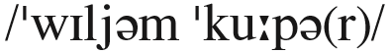
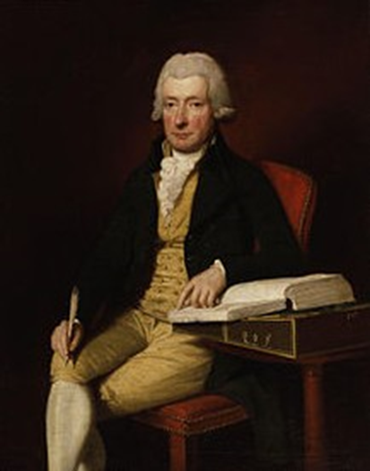
Cultural Notes
William Cowper 威廉·柯珀
William Cowper (1731–1800) was a notable English poet, writer of hymns and letter writer. He wrote gentle, pious, direct poems about everyday rural life and scenes of the countryside. He was one of the forerunners of the Romantic movement, and Coleridge called Cowper “the best modern poet”. He translated Homer’s Greek epics The Odyssey and Iliad into English.

Slide 49
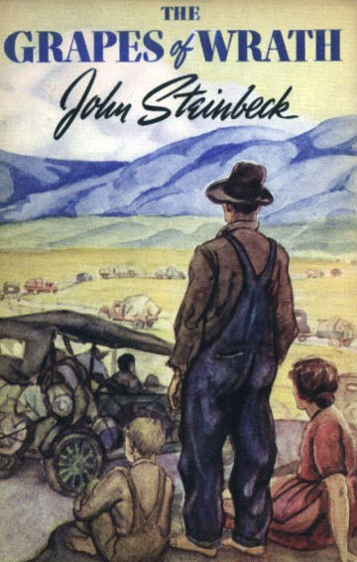
Words & Phrases
The Grapes of Wrath
《愤怒的葡萄》
The Grapes of Wrath is a novel published in 1939 and written by John Steinbeck, who was awarded the Pulitzer Prize in 1940 and the Nobel Prize for Literature in 1962.
Set during the Great Depression, the novel focuses on the Joads, a poor family of sharecroppers driven from their Oklahoma home by drought, economic hardship, and changes in financial and agricultural industries.

Slide 50
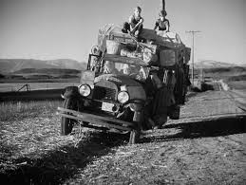
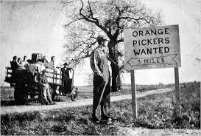
Words & Phrases
Due to their nearly hopeless situation, and in part because they were trapped in the Dust Bowl, the Joads set out for California. Along with thousands of other “Okies”, they sought jobs, land, dignity and a future. When preparing to write the novel, Steinbeck wrote: “I want to put a tag of shame on the greedy bastards who are responsible for this [the Great Depression and its effects].” He famously said, “I’ve done my damndest to rip a reader’s nerves to rags,” and this work won a large following among the working class due to Steinbeck’s sympathy to the workers’ movement and his accessible prose style.

Slide 51
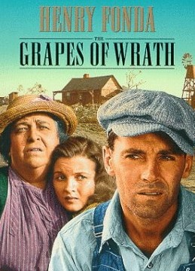

Words & Phrases
The Grapes of Wrath is frequently read in American high school and college literature classes due to its historical context and enduring legacy. A celebrated Hollywood film version, starring Henry Fonda and directed by John Ford, was made in 1940.
Movie posters of The Grapes of Wrath

Slide 52
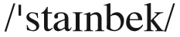
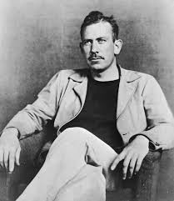
Words & Phrases
John Steinbeck 约翰·斯坦贝克
John Steinbeck (1902–1968) was a US novelist who was awarded the Nobel Prize for Literature in 1962. The Grapes of Wrath (1939) is a well-known, long tragic novel, which won the Pulitzer Prize and was made into film in 1940. Other well-known novels include Of Mice and Men (1937), Cannery Row (1945), The Pearl (1947), East of Eden (1952) and an account of a personal rediscovery of America, Travels with Charley: In Search of America (1962).

Slide 53
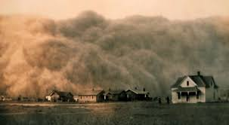
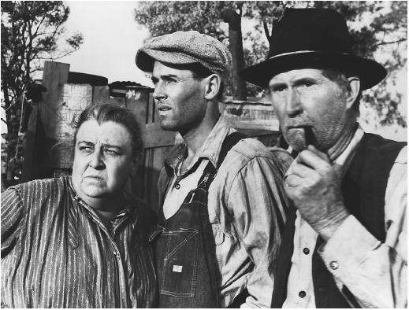
The Grapes of Wrath
Controversy
the migrant labor problem in the Great Depression of the 1930s
widespread charges of obscenity
banned and burned in Buffalo, New York; East Saint Louis, Illinois; and Kern County, California.
a classic in American literature
translated into several languages, including French, German, Chinese and Japanese.
an integral part of the school curriculum in America since the end of World War II.
Notes:
When first published, Americans had a love/hate relationship to this novel. Some people applauded Steinbeck for capturing so honestly the lives of migrant farm workers during the Depression. Other (jerks) accused him of being a socialist and of championing communist beliefs (i.e., share the wealth, friends). Californian farmers loathed Steinbeck's unsavory depiction of, well, Californian farmers. In short, this novel sent America into a bit of a frenzy.

Slide 54
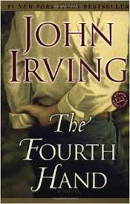
Words & Phrases
The Fourth Hand 《第四只手》 （约翰·欧文的小说）
The Fourth Hand (2001) is a comic-satirical novel about a TV journalist, Wallingford, whose left hand is seen by millions of viewers to be bitten off by a circus lion. A surgeon gives him a hand transplant (a third hand), but Doris, the wife of the dead donor, seduces Wallingford, who falls in love with her.

Slide 55
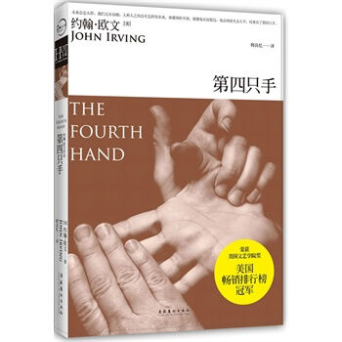
Words & Phrases
She has his child who doesn’t love him. After a year, his body rejects the transplanted hand — it is removed. But Wallingford still feels the sensation of the missing hand (like a fourth hand). Finally, Doris agrees to marry him. The themes of hands, love and life and death carry the idea of a second chance and the will to change.
Chinese edition

Slide 56
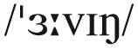
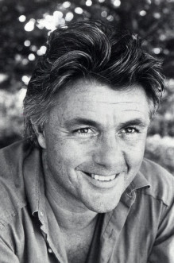
Words & Phrases
John Irving
约翰·欧文（美国当代作家）
John Winslow Irving (1942– ) is a US novelist and Academy Award-winning screenwriter who taught English at university. Some of Irving’s novels, such as The Cider House Rules and A Prayer for Owen Meany, have been bestsellers and many have been made into movies. He won the Best Adapted Screenplay Academy Award for 1999 for his script of The Cider House Rules总有骄阳.

Slide 57

Words & Phrases
Cancer Ward《癌病房》（亚历山大·索尔仁尼琴的长篇小说）
Cancer Ward is a semi-autobiographical novel by Russian author Aleksandr Solzhenitsyn, first published in 1967, and banned in the Soviet Union in 1968.
The novel tells the story of a small group of cancer patients in Uzbekistan in 1955, in the post-Stalinist Soviet Union. It explores the moral responsibility — symbolized by the patients’ malignant tumors — of those implicated in the suffering of their fellow citizens during Stalin’s Great Purge(大清洗)., when millions were killed, sent to labour camps, or exiled.

Slide 58





Words & Phrases
Different editions of the book

Slide 59
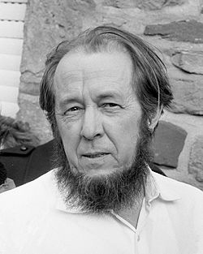
Words & Phrases
Aleksandr Solzhenitsyn
亚历山大·索尔仁尼琴（俄罗斯作家）
Aleksandr Solzhenitsyn (1918-2008) was a Russian novelist, historian, and short story writer. He was imprisoned in Soviet labour camps in 1945; after eight years, he was exiled to Kazakhstan and not freed until 1956, when he became a teacher.
In 1970 he was awarded the Nobel Prize for Literature. His best-known novels were based on his experiences as a prisoner and include: One Day in the Life of Ivan Denisovich (1962), Cancer Ward (1968), The Gulag Archipelago 《古拉格群岛》 (1973). His later works were about Russian history and identity.

Slide 60

Words & Phrases
For Whom the Bell Tolls 《丧钟为谁而鸣》（欧内斯特·海明威的长篇小说）
For Whom the Bell Tolls is a novel by Ernest Hemingway published in 1940. It tells the story of Robert Jordan, a young American in the International Brigades attached to a republican guerrilla unit during the Spanish Civil War. As an expert in the use of explosives, he is assigned to blow up a bridge during an attack on the city of Segovia. The novel is regarded as one of Hemingway’s best works, along with The Sun Also Rises, The Old Man and the Sea, and A Farewell to Arms.
1st edition cover

Slide 61
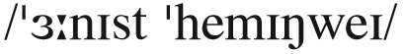
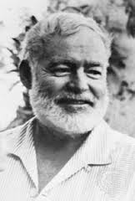
Words & Phrases
Ernest Hemingway 欧内斯特·海明威
Ernest Miller Hemingway (1899–1961) was an American author and journalist. His distinctive writing style, characterized by economy and understatement, influenced 20th-century fiction, as did his life of adventure and public image. He produced most of his work between the mid-1920s and the mid-1950s. He won the Nobel Prize in Literature in 1954. Hemingway’s fiction was successful because the characters he presented exhibited authenticity that resonated with his audience. Many of his works are classics of American literature.

Slide 62
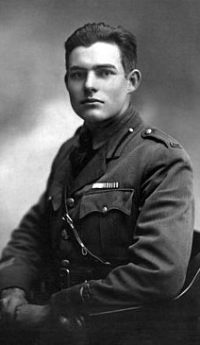
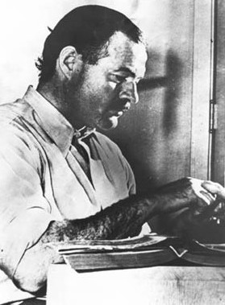
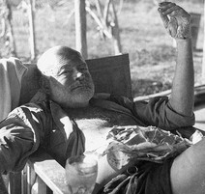
Words & Phrases
Hemingway in uniform. For two months he drove ambulances in World War I until he was wounded.
Hemingway used to be a journalist in Paris.
Hemingway at a fishing camp.

Slide 63


Words & Phrases
Our Man in Havana
《哈瓦那特派员》（格雷厄姆·格林的作品）
James Wormold, a vacuum-cleaner salesman, takes the offer to work for the British secret service in Havana. For lack of any real information, he deceives them by claiming that he has a network of agents. London then sends him a secretary, Beatrice Severn, and a radio assistant. On arriving, Beatrice announces that she has orders to take over his contacts. Her first request is to contact the pilot Raúl. Under pressure, Wormold develops an elaborate plan that would eventually result in the death of Raul. But to his surprise, Raul, a real pilot, has an accident and dies on his way to the airport. Beatrice and Wormold, try to save his fictional, now real agents from getting killed …
1st edition cover

Slide 64
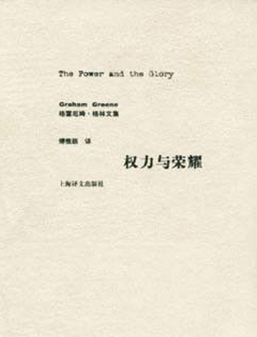
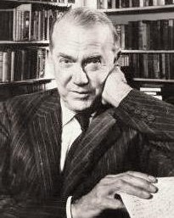
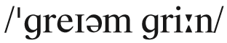


Words & Phrases
Graham Greene 格雷厄姆·格林
Henry Graham Greene (1904—1991) was a British novelist, short-story writer, playwright, travel writer and essayist. He wrote a number of thrillers (he called them “entertainments”) which dramatize an ambiguous moral dilemma, often revealing guilt, treachery, failure and a theme of pursuit. Greene was also a film critic and all of the following novels have been made into films: Brighton Rock (1938), The Power and the Glory (1940), The Heart of the Matter (1948), The Third Man (1949), The Quiet American (1955), and Our Man in Havana (1958).

Slide 65
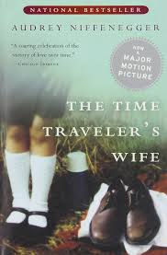
Words & Phrases
The Time Traveler’s Wife 《时间旅行者的妻子》（奥黛丽·尼芬格的小说）
The Time Traveler’s Wife is the debut novel of American author Audrey Niffenegger, published in 2003 – filmed in 2009. It is science fiction and romance best-seller about a man who travels uncontrollably in time to his own history and visits his wife in her childhood, youth and old age. His wife needs to cope with his absences and dangerous experiences while he travels. The story is a metaphor for distance and miscommunication in failed relationships.
The novel won the Exclusive Books Boeke Prize and a British Book Award.

Slide 66
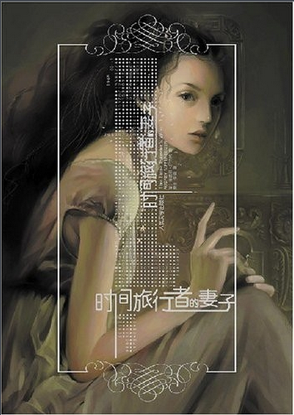
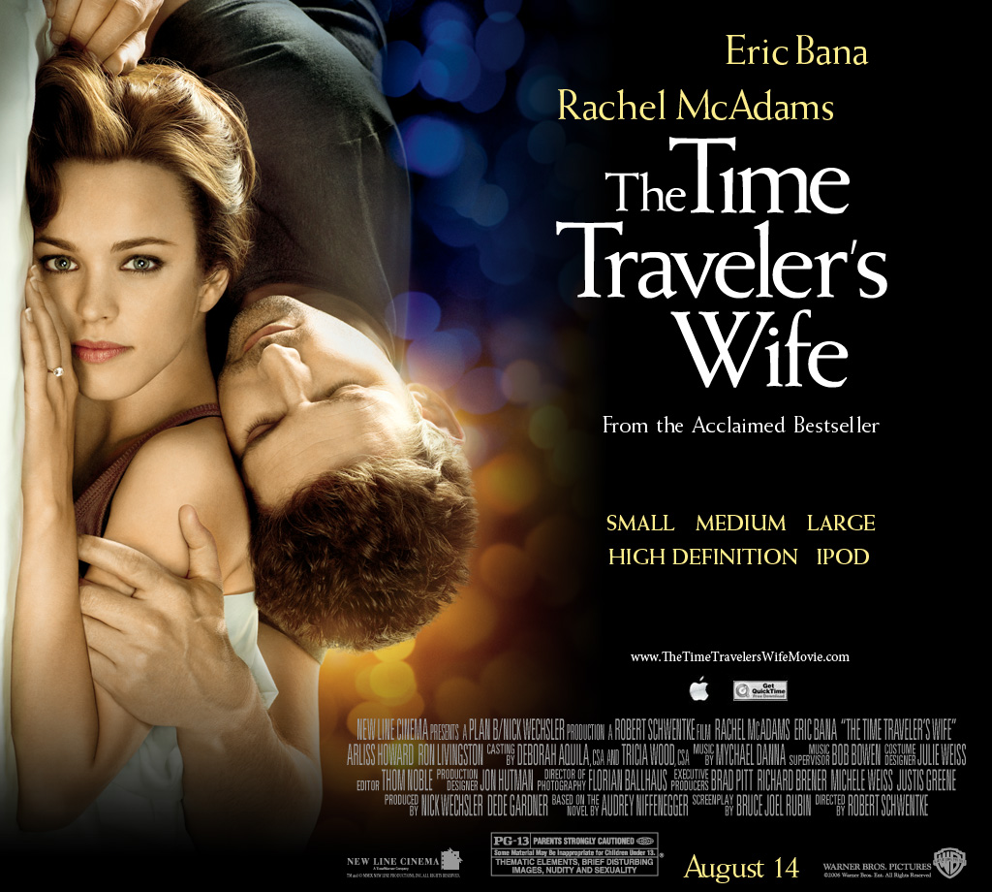
Words & Phrases
The Time Traveler’s Wife (film edition)
Chinese Edition

Slide 67
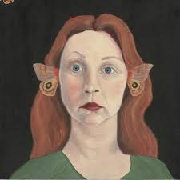
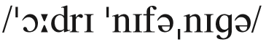

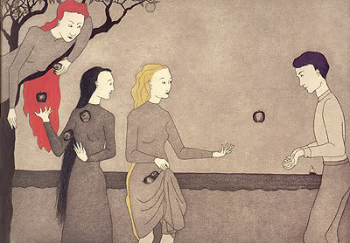
Words & Phrases
Audrey Niffenegger
奥黛丽·尼芬格
Audrey Niffenegger (1963– ) is a US writer, artist and academic, who teaches writing to visual artists and shows students how to make books by hand. The Time Traveller’s Wife was her first novel.
She has written graphic novels, or "novels in pictures" as Niffenegger calls.
The Three Incestuous Sisters

Slide 68
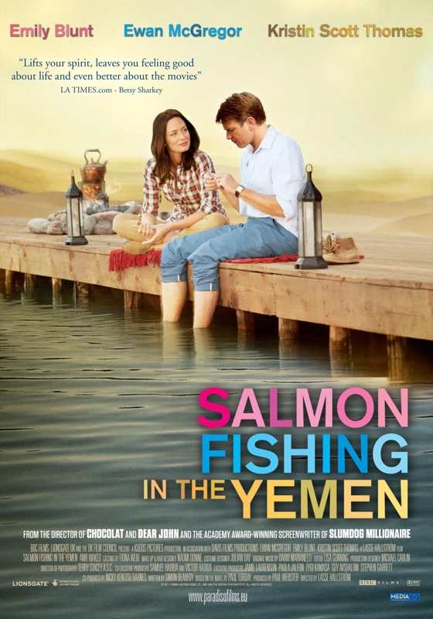
Words & Phrases
Salmon Fishing in the Yemen
《到也门钓鲑鱼》（保罗·托迪的小说）
It is a novel by British writer Paul Torday, which is a political satire and comedy about a dull civil servant who becomes involved in a plan to populate the desert with Scottish salmon. Politicians manage the media to spin this as a plan they support in order to divert attention from problems in the Middle East. There are themes of cynicism and belief, and East-West culture clashes.
The book was the winner of the 2007 Bollinger Everyman Wodehouse Prize for comic writing and was serialised on BBC Radio 4. It won the Waverton Good Read Award in 2008.

Slide 69
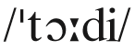

Words & Phrases
Paul Torday 保罗·托迪
Paul Torday (1946—2013) is a British writer and educated at Pembroke College, Oxford and his first novel, Salmon Fishing in the Yemen, was published at the age of 59. Prior to that he was a successful businessman living in Northumberland. The inspiration for the novel stemmed from Torday’s interest in both fly fishing and the Middle East. In 2008 he was nominated for Best Newcomer at the Galaxy British Book Awards.

Slide 70



Words & Phrases
E. M. Forster E. M.福斯特
Edward Morgan Forster (1879–1970) was a British novelist, short story writer, essayist and librettist. He lived at different periods in Italy, Egypt and India and taught at Cambridge University. His best-known novels include A Room with a View (1908), Howards End (1910), A Passage to India (1924) which have all been made into films. His writing about reading and writing includes a book of lectures, Aspects of the Novel (1927).

Slide 71



Thomas Merton
托马斯·默顿（美国作家、天主教 特拉普派修道士）
Thomas Merton (1915–1968) was a US Catholic writer, who was a Trappist monk in Kentucky. He wrote over 70 books, including many essays about Buddhism. His most famous work was his autobiography The Seven Storey Mountain (1948). He had a great deal to say about the meeting of Eastern and Western cultures and wrote many letters to writers, poets, scholars and thinkers. He read a lot in English, Latin, French and Spanish and said he always had at least three books which he was reading at any one time.

Slide 72

Words & Phrases
William Blake 威廉·布莱克（英国浪漫主义诗人）
William Blake (1757–1827) was a British poet, artist and mystic, who was acknowledged as one of the first leading figures of Romantic movement. He made many engravings to illustrate the work of such writers as Virgil, Dante and Chaucer, as well as his own poems. He stressed that imagination was more important than rationalism and materialism of the 18th century and criticized the effects of the industrial revolution in England, but his work was largely disregarded by his peers. He is best known for his poetry in Songs of Innocence (1789) and Songs of Experience (1794).
His belief in the oneness of all created things is shown in his much-quoted verse, “To see the world in a grain of sand, / And a heaven in a wild flower; / Hold infinity in the palm of your hand, / And eternity in an hour”.

Slide 73


Words & Phrases
Clifton Fadiman
克里夫顿·费迪曼（美国作家、评论家、广播和电视节目主持人）
Clifton Fadiman (1904–1999) was a US writer, radio and TV broadcaster and editor of anthologies. For over 50 years he was an editor and judge for the Book-of-the-Month Club. In 1960 he co-wrote a popular guide to great books for American readers, The Lifetime Reading Plan, which discusses many great authors and their major work.

Slide 74



Cultural Notes
base
diamond
home plate

Slide 75



Cultural Notes
The batting team
The fielding team
the pitcher
the batter

Slide 76

After-class Writing Task
Topics:
_________ is the spice of life…
Use the above incomplete sentence (fill in the blank) as the title for your writing of no more than 250 words, and give your reasons to support it.

Slide 77


After-class Task
A Good Read is one of BBC Radio 4's longest-running programmes; in it two guests join the main presenter to choose and discuss their favourite books. Sue MacGregor stepped down in 2010 as the programme's longest-serving presenter (seven years).[1] Her successor is the writer, broadcaster and academic Harriett Gilbert, who took up the reins in May 2011. Previous presenters have included the novelist Louise Doughty 1998 to 2001.
The programme began in 1977 and has been produced by BBC Bristol over that time.

Slide 78

After-class Task

Slide 79

After-class Task
A Good Read is one of BBC Radio 4's longest-running programmes; in it two guests join the main presenter to choose and discuss their favourite books. Sue MacGregor stepped down in 2010 as the programme's longest-serving presenter (seven years). Her successor is the writer, broadcaster and academic Harriett Gilbert, who took up the reins in May 2011. Previous presenters have included the novelist Louise Doughty 1998 to 2001.
The programme began in 1977
Books worth reading.

Slide 80
After-class Task
Our class began to produce a ten-minute TV programm ________ to introduce your favorite books for reading;
Each group as the panelists collectively choose one favorite book for your introduction;
The program should be interesting and appealing, with book introduction about
the book title, writer, contents,… and the reasons for choosing it.
The book introduced is on the reading list of most of the classmates is the winner!
Books worth reading.

Slide 81


After-class Task

Slide 82
Extension Activities
Listen to a passage about baseball and fill in the blanks.
Baseball is America’s national sport. So it is not unusual that many popular expressions come from baseball. But first, let me explain a little about the game.
Each baseball team has nine players. The _______ of one team throws the ball to a batter from the other team. The batter attempts to hit the ball. If he misses, it is called a strike. If a batter gets three strikes, he loses his turn at bat and is called out. ________________________________________________ _______________________________________________. But if the batter hits the ball and it is not caught, the batter tries to run to one or more of the four bases on the field. The batter can run to all four bases if he hits the ball over the fence or out of the ballpark. _______________________.
Key

Slide 83

Extension Activities
Baseball is America’s national sport. So it is not unusual that many popular expressions come from baseball. But first, let me explain a little about the game.
Each baseball team has nine players. The _______ of one team throws the ball to a batter from the other team. The batter attempts to hit the ball. If he misses, it is called a strike. If a batter gets three strikes, he loses his turn at bat and is called out. ________________________________________________ _______________________________________________. But if the batter hits the ball and it is not caught, the batter tries to run to one or more of the four bases on the field. The batter can run to all four bases if he hits the ball over the fence or out of the ballpark. ______________________________.
pitcher
The batter also is out if he
hits the ball in the air and an opposing player catches it
Such a hit is called
a home run

Slide 84


Extension Activities
Listen to a passage about baseball and try to explain the following baseball terms.
1. on the ball
2. throw a curve ball
3. step up to the plate
4. a pinch hitter
5. strike out / go down swinging
6. hit a home run / hit it out of the park
7. touch base with sb.
8. touch all the bases
9. cover one’s bases
10. be way off base
11. a whole new ballgame
Script

Slide 85

Extension Activities
1. on the ball
intelligent and able to do a good job
2. throw a curve ball
do sth. unexpected
3. step up to the plate
be ready to do one’s job
4. a pinch hitter
a person who takes the place of sb. else at a job or activity
5. strike out / go down swinging
attempt sth. but fail

Slide 86

Extension Activities
6. hit a home run / hit it out of the park
do sth. extremely well
7. touch base with sb.
talk to sb. from time to time about sth. you plan to do
8. touch all the bases
do what is necessary to complete a job or activity
9. cover one’s bases
be well prepared
10. be way off base
do sth. wrong or maybe even dishonest or immoral
11. a whole new ballgame
a completely-changed situation

Slide 87
Extension Activities
Script
Baseball is America’s national sport. So it is not unusual that many popular expressions come from baseball. But first, let me explain a little about the game.
Each baseball team has nine players. The pitcher of one team throws the ball to a batter from the other team. The batter attempts to hit the ball. If he misses, it is called a strike. If a batter gets three strikes, he loses his turn at bat and is called out. The batter also is out if he hits the ball in the air and an opposing player catches it. But if the batter hits the ball and it is not caught, the batter tries to run to one or more of the four bases on the field. The batter can run to all four bases if he hits the ball over the fence or out of the ballpark. Such a hit is called a home run.

Slide 88
Extension Activities
Now, here are some common expressions from baseball. Someone who is on the ball is intelligent and able to do a good job. But a person who threw a curve ball did something unexpected. Someone who steps up to the plate is ready to do his or her job. A pinch hitter takes the place of someone else at a job or activity.
A person who strikes out or goes down swinging attempted something but failed. We also might tell the person that three strikes and you are out. But someone who hit a home run or hit it out of the park did something extremely well.

Slide 89
Extension Activities
If I say I want to touch base with you, I will talk to you from time to time about something we plan to do. I might say I touched all the bases if I did what is necessary to complete a job or activity. And if I covered my bases I was well prepared. However, someone who is way off base did something wrong or maybe even dishonest or immoral.
Finally, when a situation changes completely, we say that is a whole new ballgame.

Slide 90

Thank you

